Slide 1
Era Of Big Data
How it evolved and what is is for us in current market trends

Slide 2
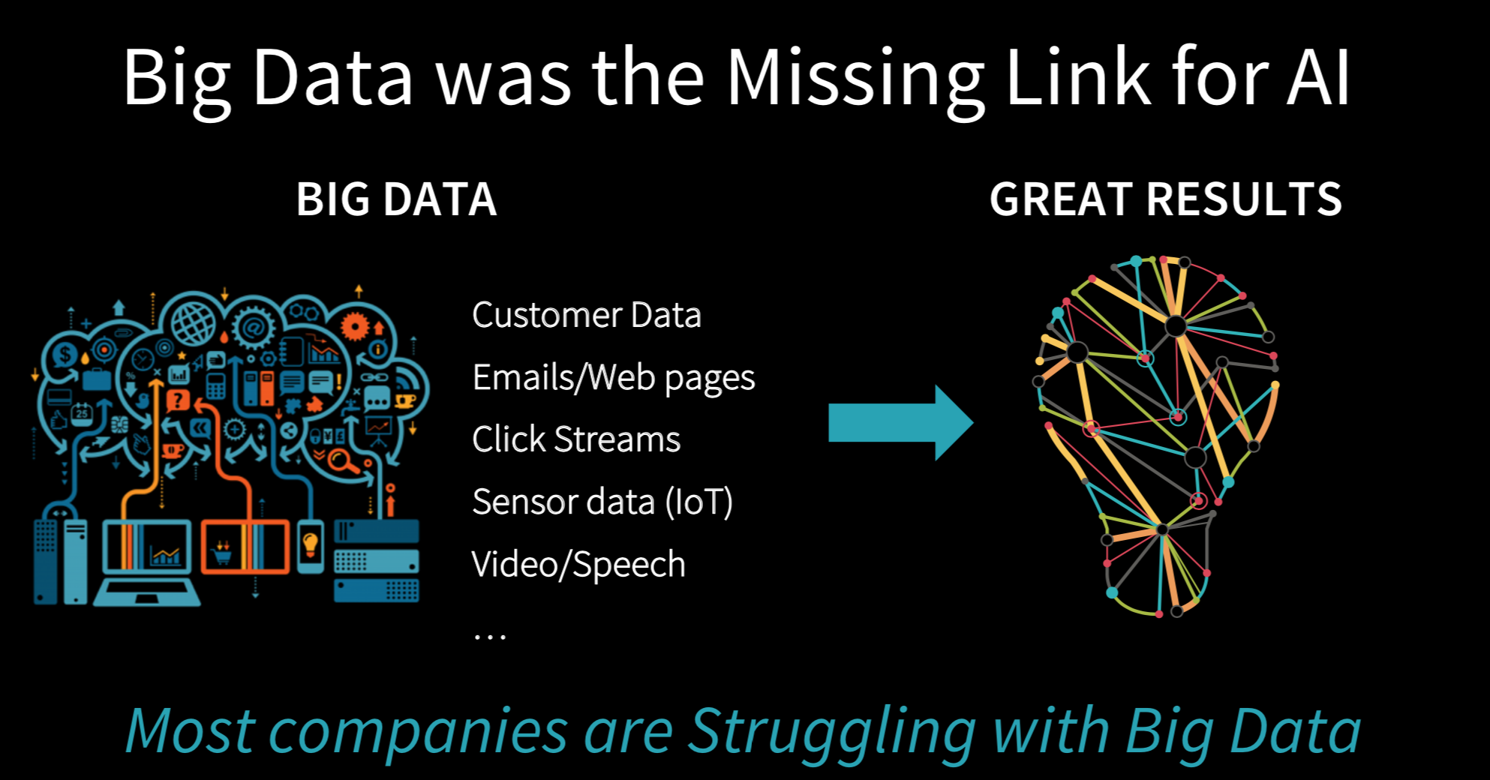

Slide 3
BigData is not only Hadoop

Slide 4
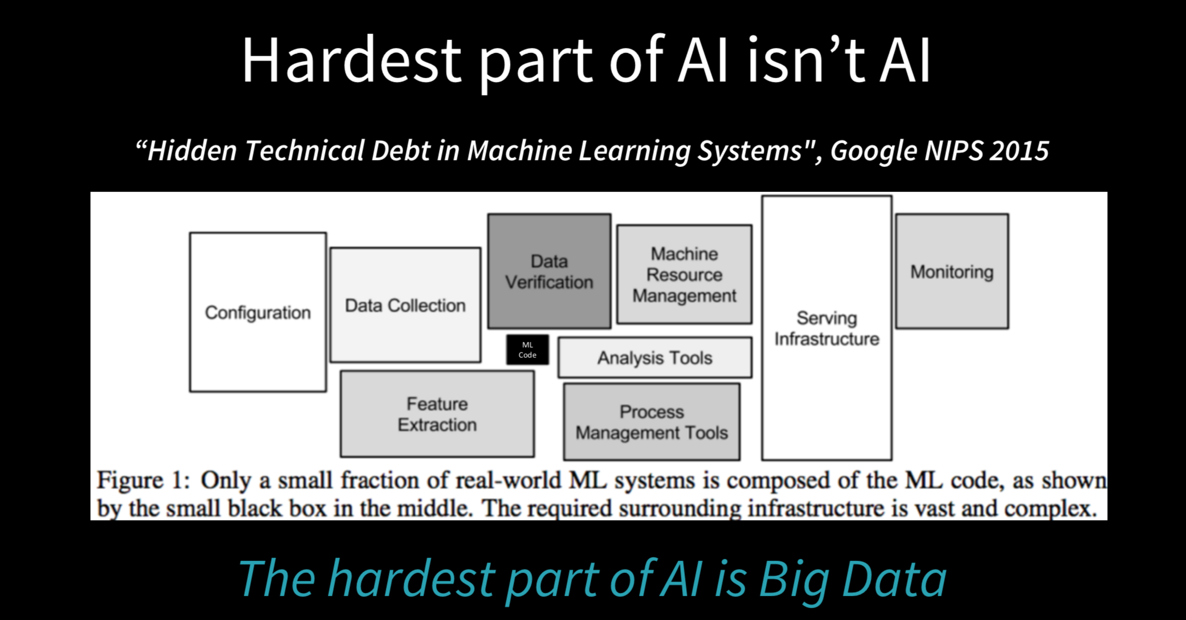

Slide 5
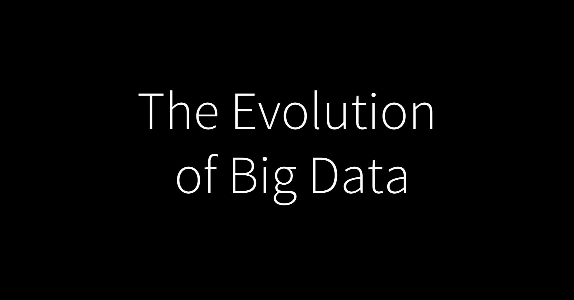

Slide 6
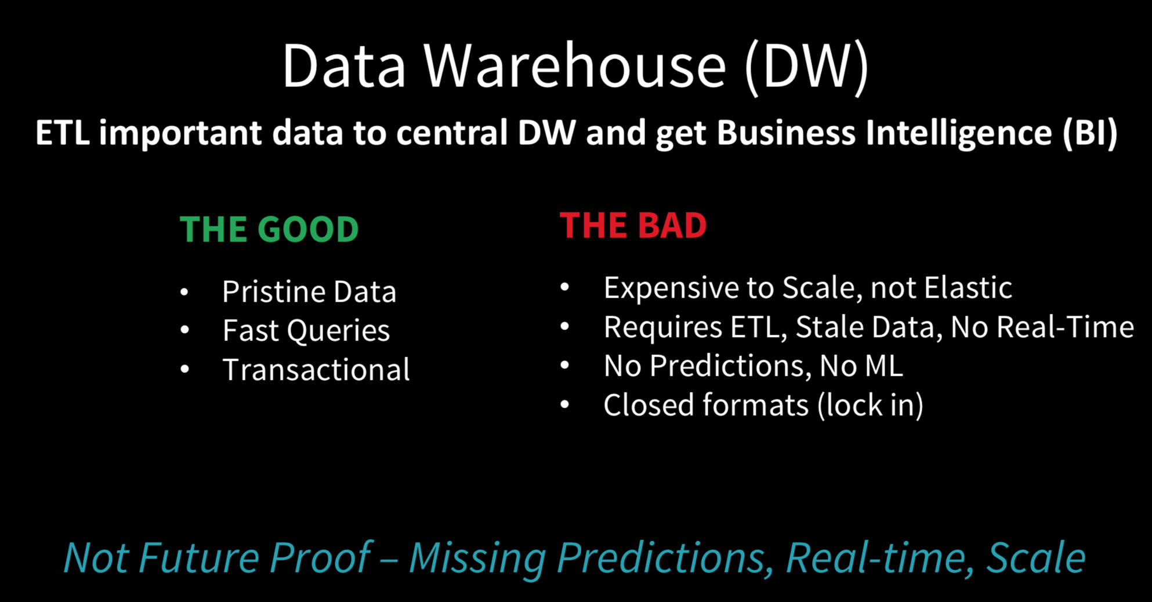

Slide 7


Slide 8
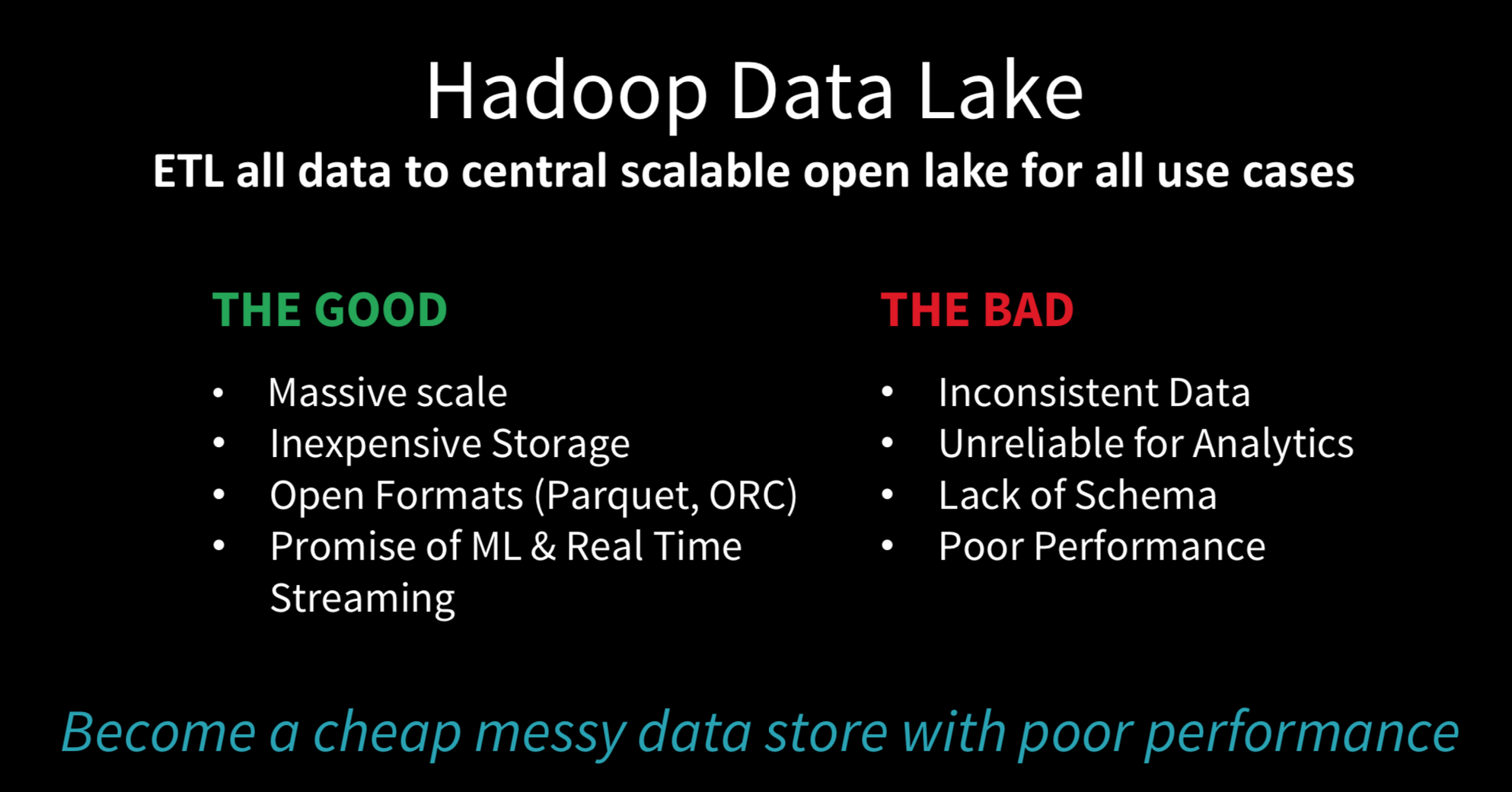

Slide 9


Slide 10
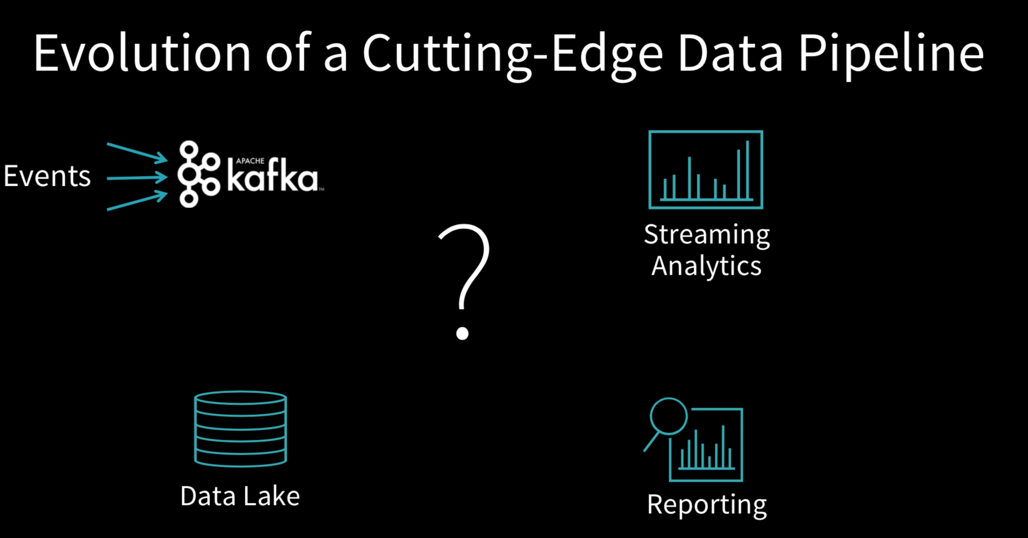

Slide 11
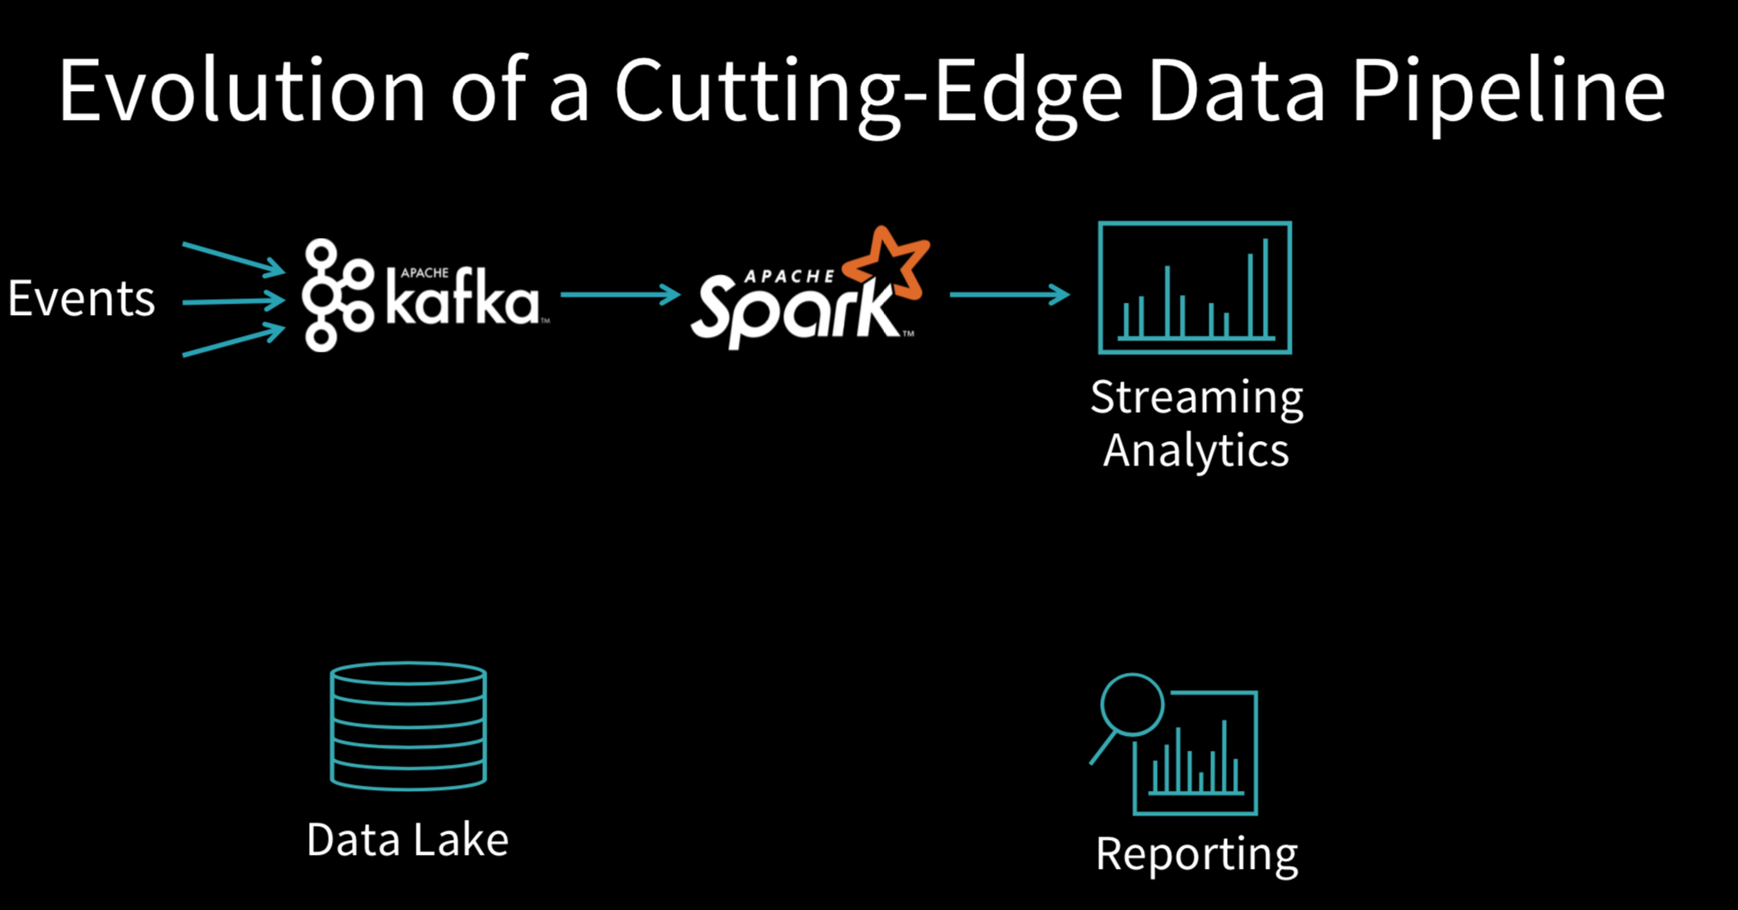

Slide 12
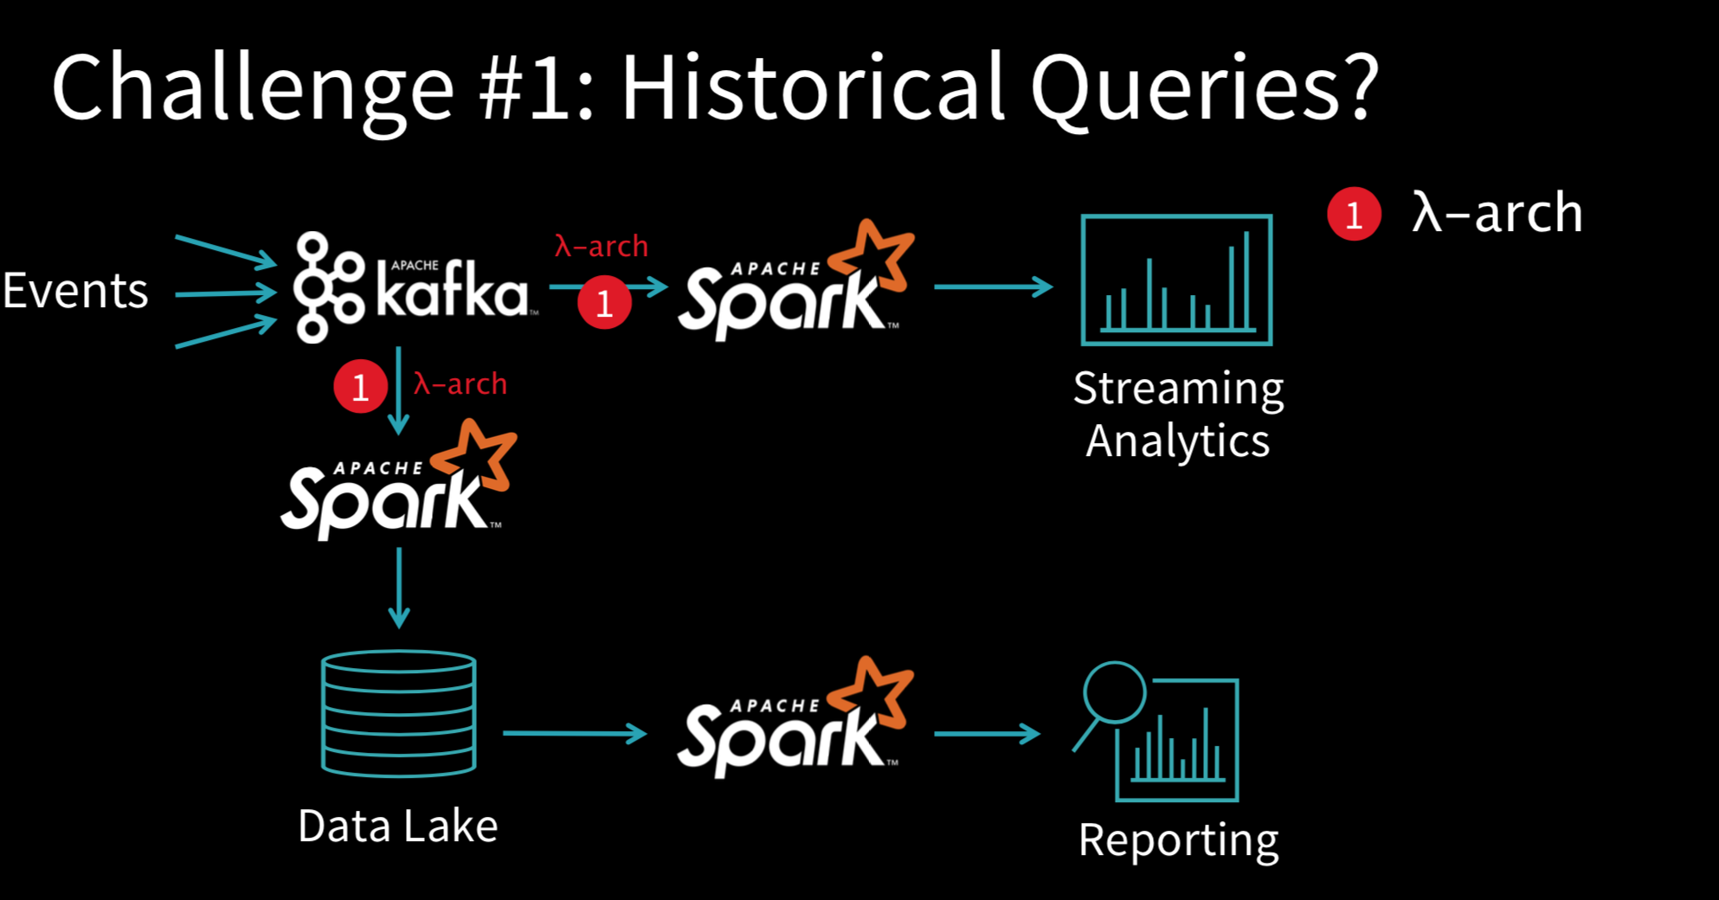

Slide 13
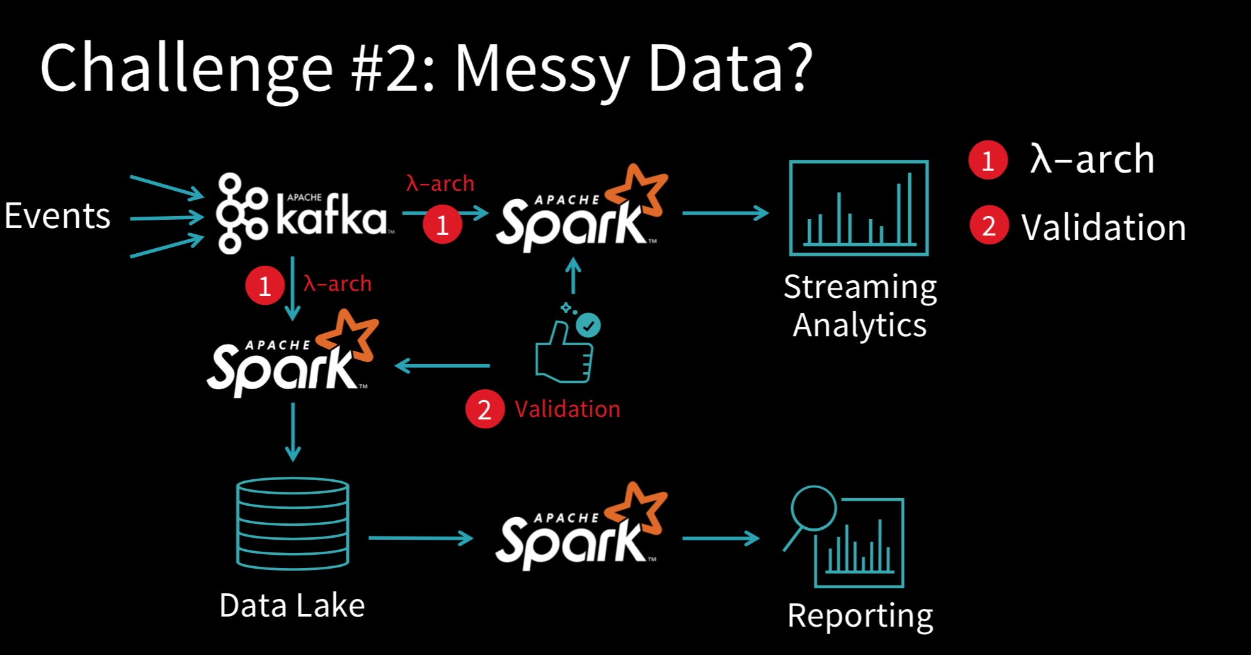

Slide 14
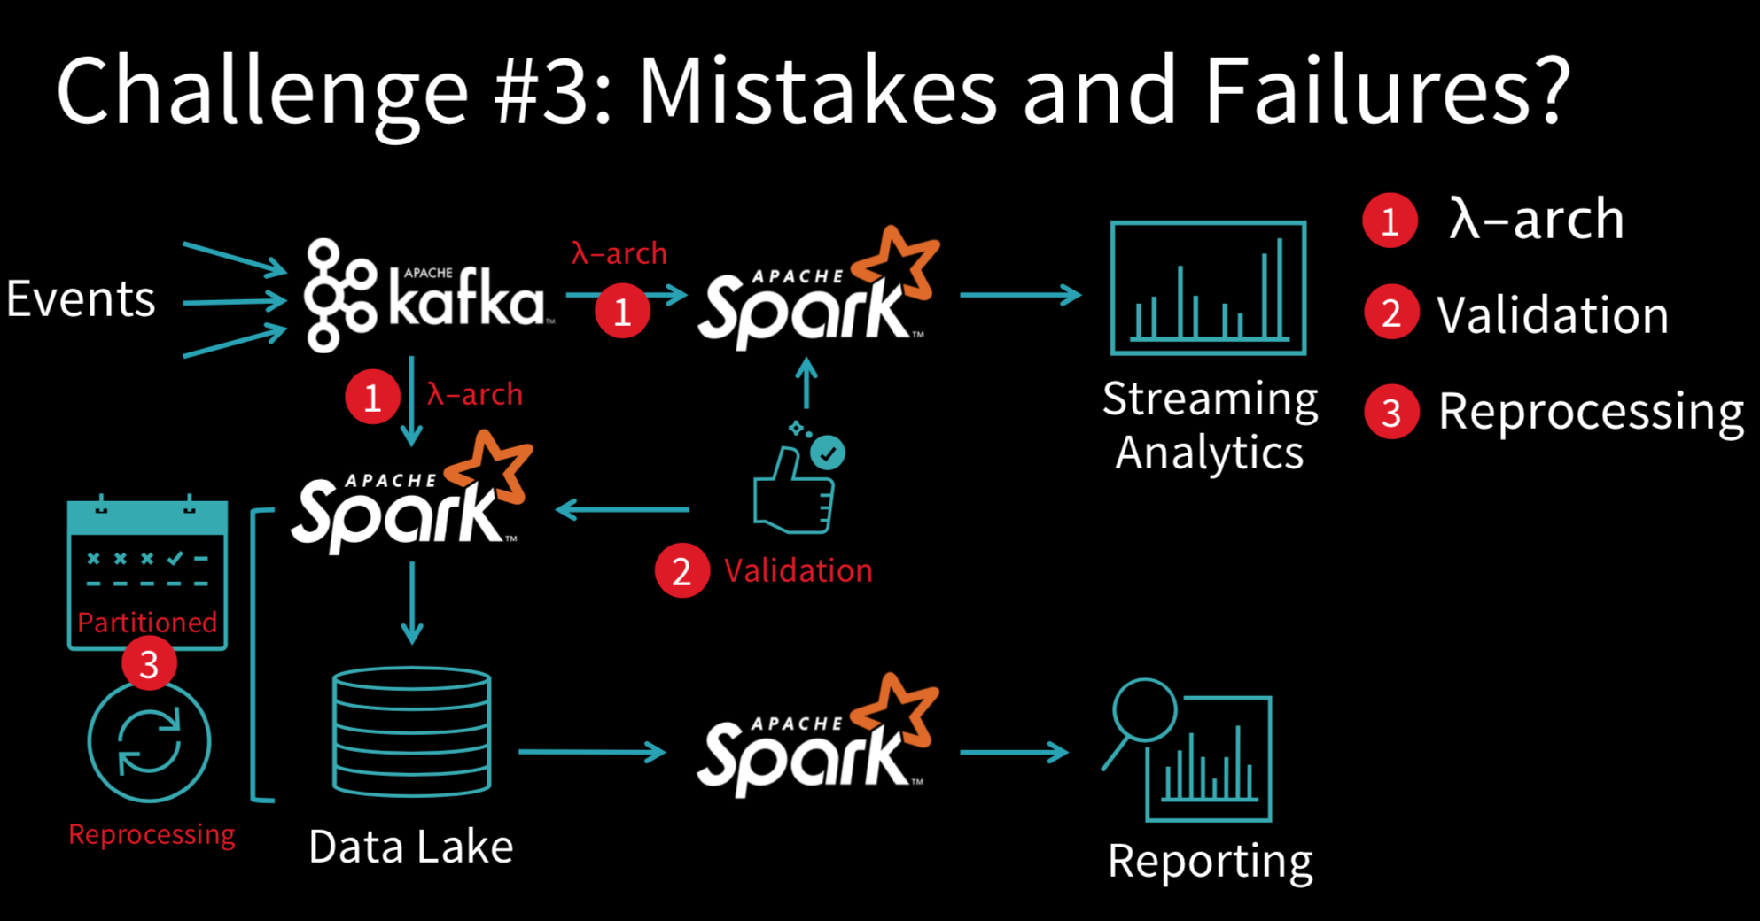

Slide 15
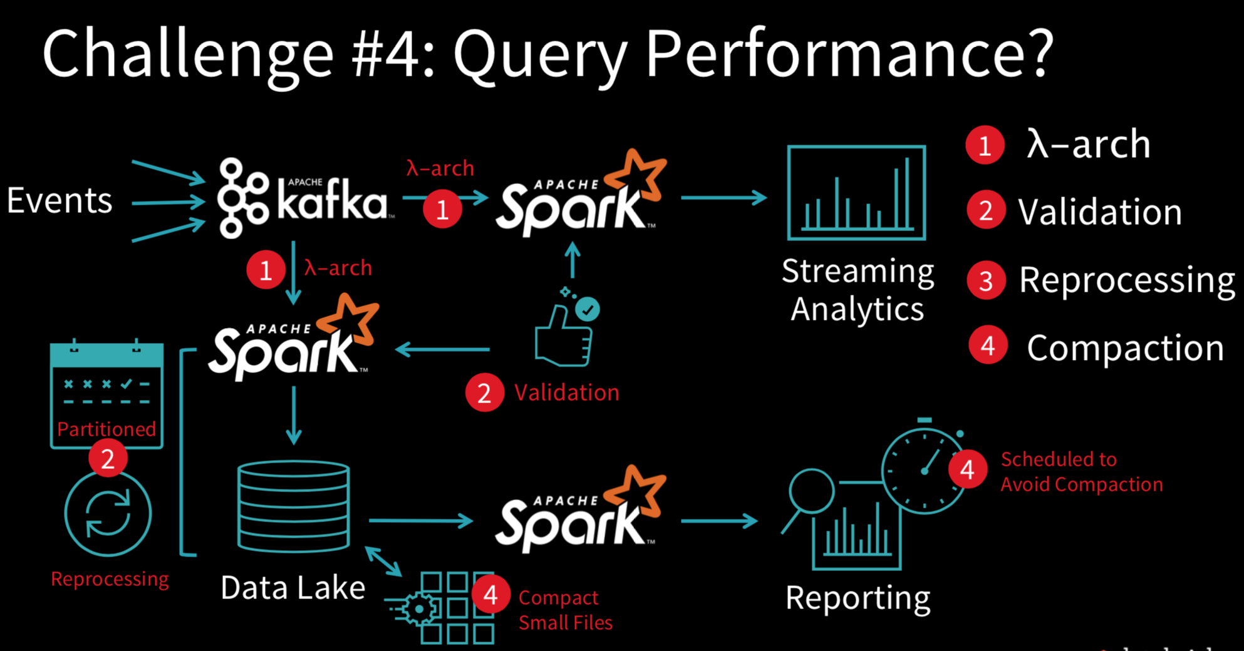

Slide 16
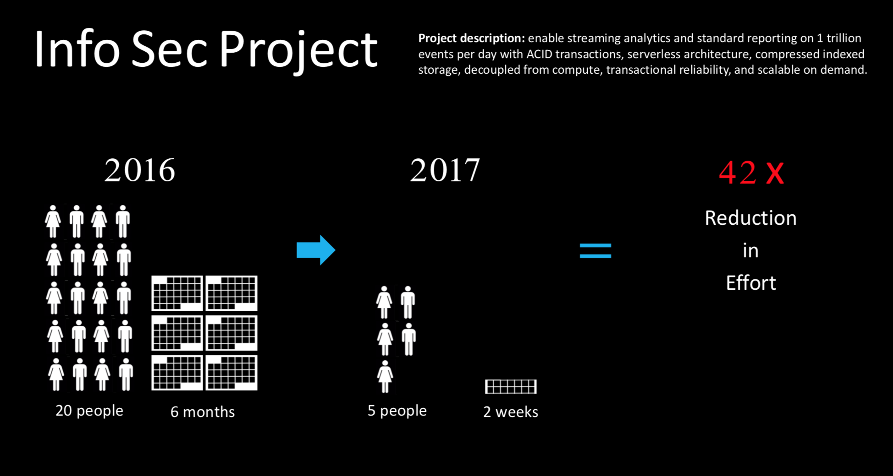

Slide 17
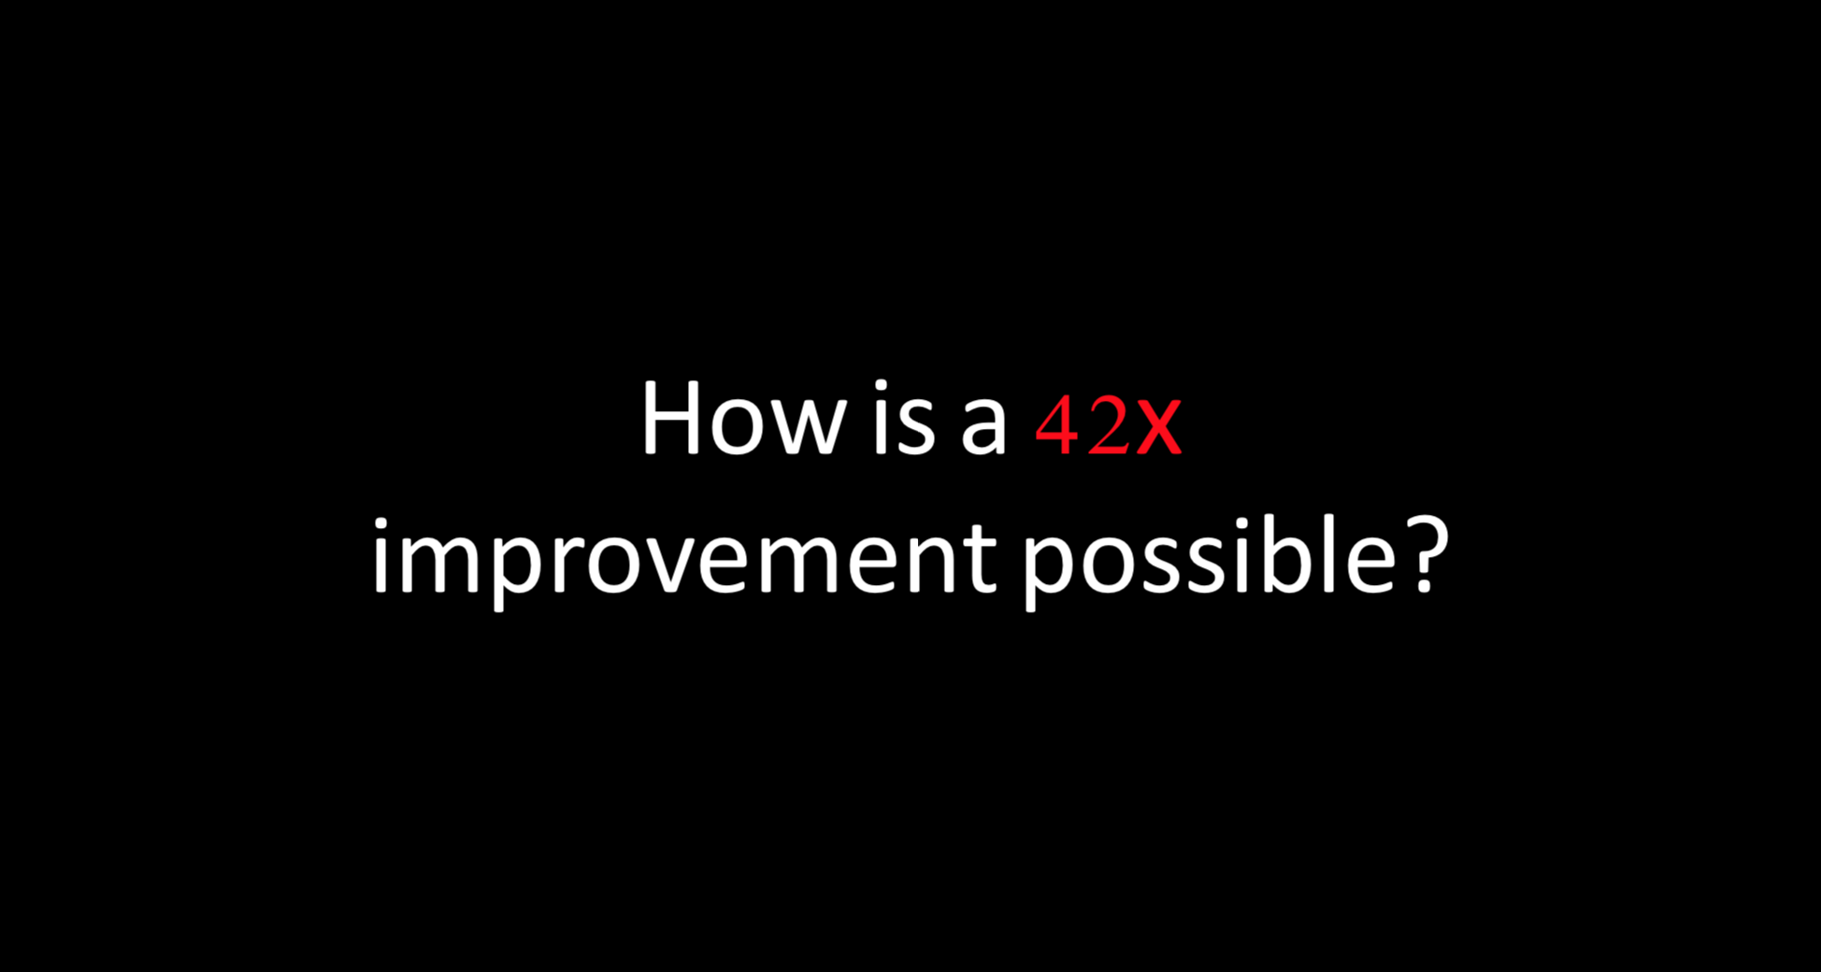

Slide 18
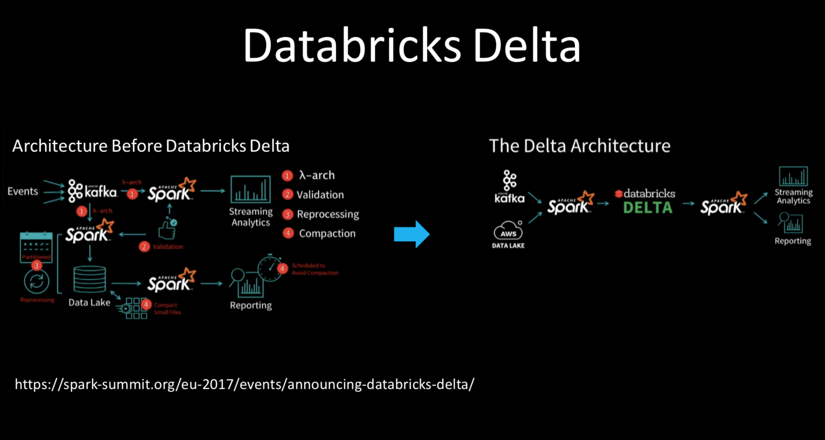

Slide 19
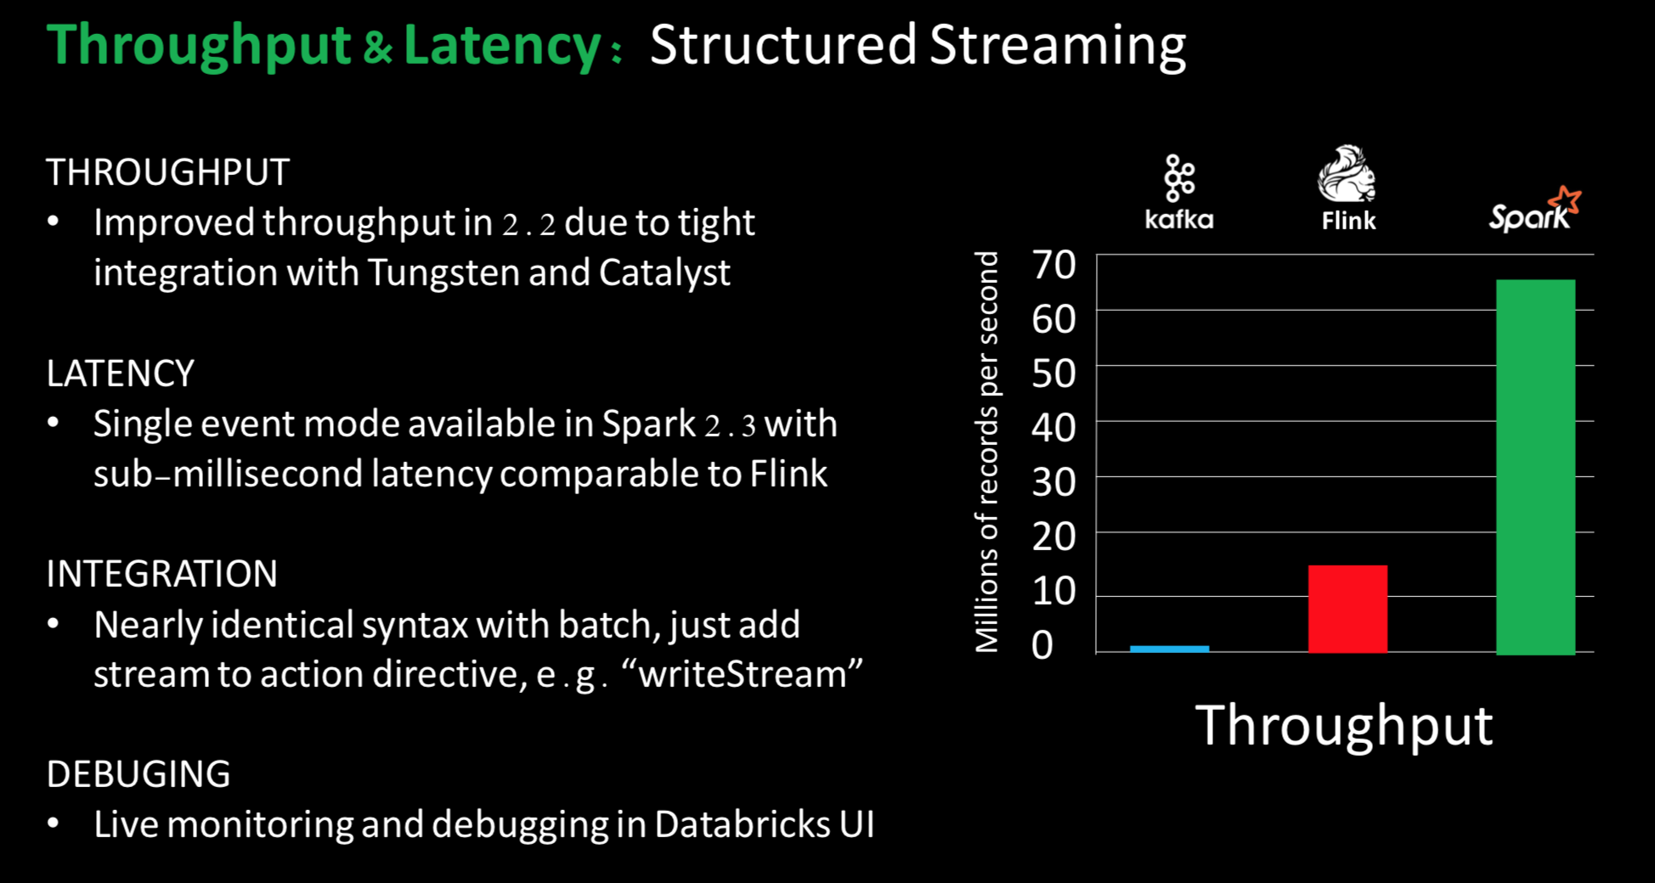

Slide 20
What we do – Next 3 Days
Understanding Data warehouse in Azure
Understanding Data Lake
Understanding Data Factory
Understanding Data Bricks as a whole.
Build an end to end system with all the above .

